Slide 1
Lecture 11
The future of Bitcoin?

Slide 2
Decentralize everything!

Slide 3
Lecture 11.1:
The block chain as a vehicle for decentralization

Slide 4
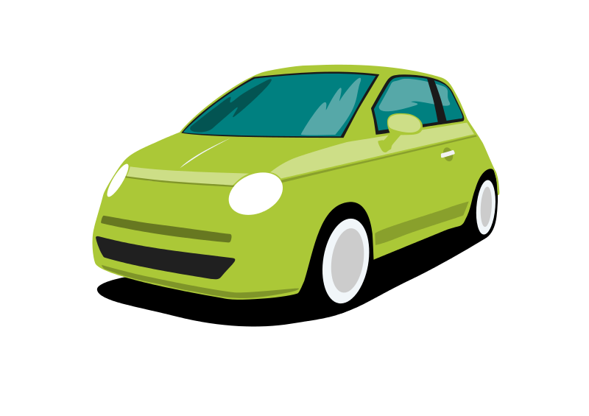

Motivating example: smart property
Step 1: car controlled by a
cryptographic key
Car has public key hard-coded
Activated upon receiving message signed by corresponding private key

Slide 5

Motivating example: smart property
Step 2: public key is dynamically updated based on Bitcoin block chain
Alice owns the car because she controls private key of green Tx output
signed by A
Now Bob’s key activates car
Transfer
Pay to pk_{B}: H( )

Slide 6

Motivating example: smart property
Step 3: Create a single transaction that combines Bob’s payment to Alice and Alice’s ownership transfer to Bob
Alice and Bob sign separately, then broadcast

Slide 7
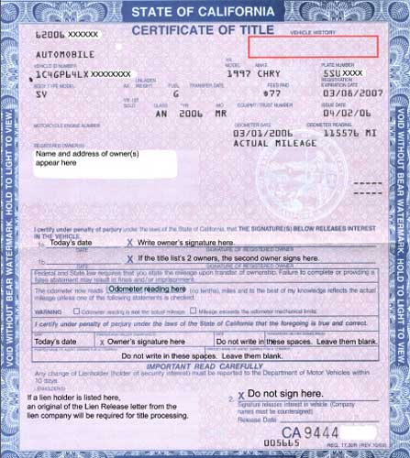
Decentralized property ownership

Slide 8
Representation and atomicity
Representation:
How to encode complex transactions into the block chain?
Atomicity:
How to couple the actions of the various parties?

Slide 9
Questions
What else can we decentralize this way?
Can these be done on Bitcoin or do they require a separate block chain?
Are there alternatives to atomicity?
Is it a good idea to do commerce like this?

Slide 10
Lecture 11.2:
Routes to block chain integration

Slide 11
Route 1: Directly on Bitcoin
Advantage:
easy to deploy
Disadvantages: limited representation and atomicity

Slide 12



Example: crowd funding
Single Tx with arbitrary number of inputs and 1 output
Spendable only if Σ(inputs) ≥ output
Each funder signs only her own input and the output
2
5
1000
…
4

Slide 13
Example: pay for proof
Alice knows x such that H(x) = c
Bob would like to pay Alice in exchange for x
Bob’s Payment should be atomically coupled with Alice’s publication of x on block chain
Possible but unwieldy

Slide 14
Route 2: Embedding
Recall: Colored coins
Similar to representation of car ownership, but relies on entire history
Recall: Mastercoin

Slide 15
Route 2: Embedding
Advantages:
Complex representations possible
Security of Bitcoin block chain
Disadvantages:
Limited scripting and atomicity
Results in unwanted Tx’s in block chain

Slide 16
Route 3: Side chains
Recall:
merge-mined, 1-1 pegged Bitcoin testbed
Advantage:
Avoids polluting the block chain
Disadvantage:
Requires Bitcoin modifications

Slide 17
Route 4: Altcoins
Example: Ethereum
General framework for ledger-based consensus
Turing-complete scripts
Pay for miner computation using “gas”

Slide 18
Which approach to use?
Conceptually, any of the four can implement smart property
Differences in power and flexibility
Practical differences, e.g: SPV feasibility

Slide 19
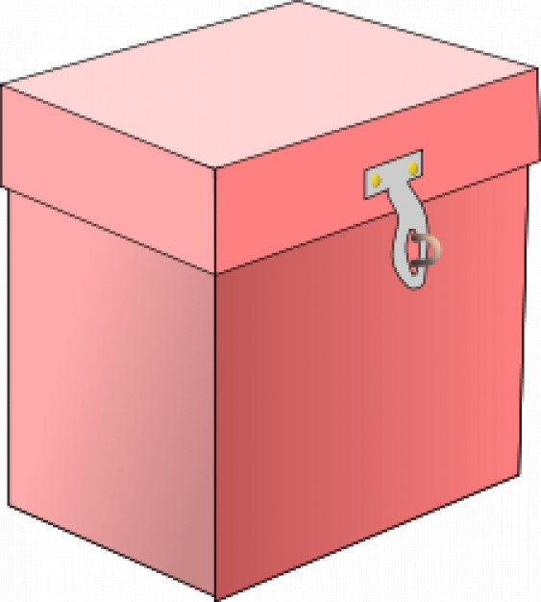
Back to the car sale example
What about a dispute?
Recall: 2-out-of-3 escrow
2-out-of-3:
Alice, Bob, Judy

Slide 20
Comparison to legal remedy
Advantage(?):
Alice and Bob have freedom to choose mediator Judy
➔ competition between intermediaries
Disadvantage:
Funds tied up during mediation

Slide 21
Competing intermediaries
Recall: decentralized prediction market achieved by allowing anyone to start a market

Slide 22
Levels of (de)centralization
Single mandatory intermediary
Multiple competing intermediaries
“Threshold” of intermediaries
No intermediary

Slide 23
Improving security
Reputation
Escrow & dispute mediation
Atomic exchange
Trusted hardware
Limitations due to lack of real-world enforcement:
no debt or punitive measures
Seen so far

Slide 24
Security: vocabulary
Trust minimization
Lack of trust is (unfortunate) starting point, not a goal!

Slide 25
A generic decentralization template
What is being decentralized
Type of block chain integration
Level of decentralization
How security is achieved
Seen so far
Allows succinctly representing almost any
proposal for block chain based decentralization

Slide 26
Example: smart property
Decentralizes
in the sense of
using
via
property ownership and trading
disintermediation
Bitcoin
atomicity

Slide 27
Example: decentralized prediction markets
Decentralizes
in the sense of
using
via
prediction markets
competition
an Altcoin
atomicity

Slide 28
Example: StorJ
“Agent” that lives in the cloud
Pay to store a file for fixed period (say 1 day)
Has other aspects such as reproduction
(ignore for now)

Slide 29
Example: StorJ
Decentralizes
in the sense of
using
via
file storage and retrieval
competition
Bitcoin
reputation

Slide 30
Example: Zerocoin
Decentralizes
in the sense of
using
via
mixing
disintermediation
an Altcoin
atomicity

Slide 31
Lecture 11.3:
What can we decentralize?

Slide 32
1. Purely digital things
Name mapping
Storage
Pay for proof
Random number generation
Lotteries

Slide 33
2. Things that can be represented digitally
Real-world currencies
Stocks
Other assets

Slide 34
3. Property ownership and trade
Smart property and atomic exchange

Slide 35
4. Complex contracts
Crowd funding
Financial derivatives
Requires price data feed unless underlying asset is traded on block chain

Slide 36
5. Markets and auctions
Centralized markets:
Used bike store — buys your bike, sells it later
EBay — matches participants, routes payments
PayPal — processes payments, (some) dispute mediation
Craigslist — matches participants

Slide 37
How to decentralize markets
Payment
Transfer of goods
Dispute handling
Matching participants
Bitcoin
smart property, atomicity
escrow
??

Slide 38
Decentralized matching
Broadcast partially complete transaction to P2P network
Counterparty finds it, completes, signs, broadcasts
Variant: use block chain instead of P2P network

Slide 39
Variant: auction
Counterparty can’t complete directly, must return to auction creator

Slide 40
Variant: double auction (order book)
Both sides simultaneously broadcast partial transactions
Miners match orders, keep bid-ask spread (Avoids miner front-running)

Slide 41
6. Data feeds
Recall:
data feeds allow arbiters to assert facts about the world into the block chain
Examples:
price movements, outcomes of events…
Big incentives to lie!

Slide 42
Decentralization by voting
Centralized version: Tx corresponds to event E with outcomes X, Y, Z
Transfer to pk_{X} if outcome X happens
Signed by arbiter A
E
signed by A
Transfer
Pay to pk_{X}: H( )

Slide 43
Decentralization by voting
Decentralized version:
E is a 2-out-of-3 multi-sig address controlled by A, B, C
E
signed by A, C
Transfer
Pay to pk_{X}: H( )

Slide 44
Levels of (de)centralization
Single mandatory intermediary
Multiple competing intermediaries
“Threshold” of intermediaries
No intermediary

Slide 45
7. Autonomous agents
Key features
Contracts
Data feeds
Voting as a way to change the rules
Some variants: reproduction
Challenges
Keeping private state
Hostile takeover

Slide 46
Autonomous agents: terminology
Decentralized Autonomous Corporation
Preserves few of the salient features of corporations

Slide 47

8. Exchanges
The problem:
Alice would like USD for BTC
Carol would like BTC for USD
They don’t trust each other
Luckily, they have a mutual friend Bob
A
B
C

Slide 48
Let’s make this more efficient
I owe you $100
I owe you $100
A
B
C

Slide 49
And scale it up
Pairs of friends pre-declare how much debt they’re willing to extend
Triangular debt cancellation means actual settlement may be rare
IOU

Slide 50
Ripple
Decentralizes
in the sense of
using
via
currency exchange
disintermediation
an Altcoin
transitive trust

Slide 51
Lecture 11.4:
When is decentralization a good idea?

Slide 52
What we’re really talking about:
Technological alternatives to human institutions — legal, social and financial
Recall: Cypherpunk roots

Slide 53
Back to the car example
What are the problems with car ownership and trade?
Security (theft)
Disputes about sale terms
What happens in a smart property model?

Slide 54
Security is complex
Preventive, detective and corrective controls
Real-world solution relies on law enforcement

Slide 55
Bitcoin security
Unsolved problem for the foreseeable future
Software security is partly a human problem
Excessive reliance can cause serious problems
Loss of key → car turns into brick?

Slide 56
Dispute mediation is complex
Fundamentally a human problem
Real-world solution: court system, especially small-claims courts

Slide 57
Crowd funding security
Also fundamentally a human problem
Entrepreneur can take the money and run

Slide 58
Smart property model
Didn’t solve existing (social) problems
In fact, made them harder to solve
Introduced new problems

Slide 59
Possible benefits of smart property
Efficiency for small transactions
Anonymity & privacy
Freedom to choose mediator

Slide 60
Crypto and the state
The state is one way to scale society past small groups where everyone trusts each other
Crypto is another
Dismantling the state is not an option
How can the two work together?

Slide 61
The big opportunity
Find compelling use-cases for decentralization
Integrate into existing systems
Co-opt legal and regulatory practices

Slide 62
Next steps
Assignments, eventually
Message boards, research groups

